Slide 1
Lab (6) Introduction to Assembly Language

Slide 2
Introduction
Objectives :
Learn
•EMU8086 installation
•EMU8086 environment Learn how to:
•Assemble instructions into the memory of 8086 using Emu8086
•Use Emu8086 to execute instructions
•Run opt-in programs in EMU8086
•Write a complete assembly program.
•Edit an existing source program.

Slide 3
Part I: Introduction to Emu8086
“An Integrated Development Environment (IDE) provides a convenient environment to write a source file, assemble and link it to a -.COM or -.EXE file, and trace it in both source file, and machine code. Emu86 is an educational IDE for assembly program development. You can download the latest student version of EMU86 from the web page www.emu8086.com. It is a Windows program, and will run by dragging an -.ASM, -.OBJ, -.LST, -.EXE , or -.COM file into the emu86 shortcut icon. By this action, asm or lst files will start the 8086 assembler source editor, while obj and exe files starts the disassembler and debugger units.

Slide 4
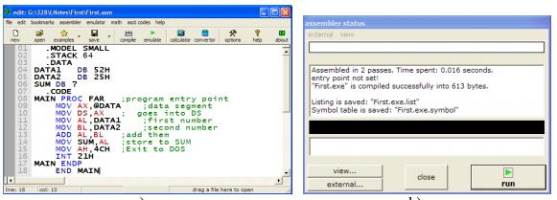
EMU8086 Source Editor
The source editor of EMU86 is a special purpose editor which identifies the 8086 mnemonics, hexadecimal numbers and labels by different colors as seen in Figure 1.

Slide 5
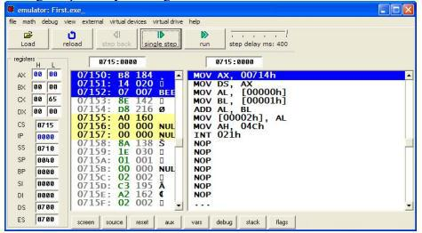
The compile button on the taskbar starts assembling and linking of the source file. A report window is opened after the assembling process is completed. Figure 2 shows the emulator of 8086 which gets opened by clicking on emulate button

Slide 6
Part 2: Opt-in Examples in Emu8086
Look at “Code Examples‟.
After opening one of the code samples, then press “emulate‟, then „run‟. Also try these :
“add/subtract‟
“palindrome‟
“traffic lights‟
“led test‟
“stepper motor‟
“thermometer‟

Slide 7
Part 3: Assemble and execute instructions in Emu8086

Slide 8
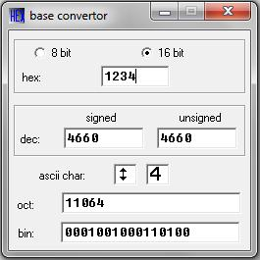
Use emu8086 to make the calculations following
a) 10100101b = ?
b) 12h = ?
c) 39 = ? h
Procedure:
Choose “Math” and specify “Base Convertor” in emu8086.
Enter one of the numbers like in the Figure 3

Slide 9
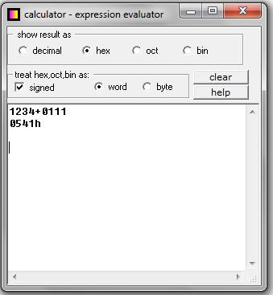
Use EMU8086 to evaluate an expressions
Evaluate : 0FFFFh *10h +0FFFFh
Procedure:
1. Choose “Math” and specify “Multi Base Calculator” in emu8086.
2. Enter the expression like in the Figure 4.

Slide 10
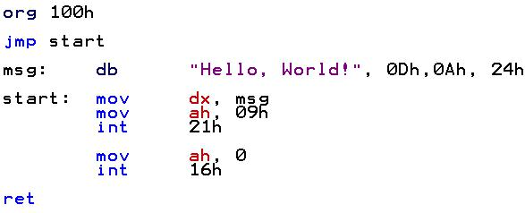
Part 4: Writing and Running Assembly Code in Emu8086
In this part, we are entering Assembly language world. Let‟s say ,, hello‟

Slide 11
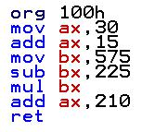
Part 5: Exercise Part
Calculate : (30 ₁₀ + 15 ₁₀ ) * ( 575 ₁₀ – 225 ₁₀ ) + 210
1. Choose “New” and specify “COM template” in emu8086.
2. Enter the following code to the editor:

Slide 12
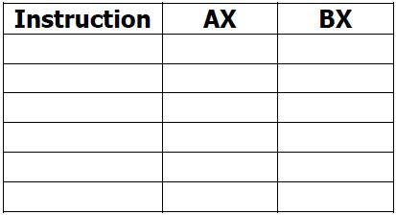
3.“ Start emulation by clicking the “emulate” button on the toolbar. A new emulator window will appear.
4. Single-step the program codes by pressing the “single step” button on the toolbar of the emulator window.
5. Each time after pressing the “single step” button, check and record down the contents of AX and BX registers in Table 1

Slide 13
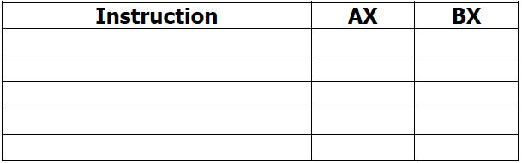
Exercise - 2
In this example, we will develop a program to perform the following arithmetic operations:
12 ₁₀ * ( 200₁₀ – 225 ₁₀ ) + 127
Procedure:
1. “ Develop an assembly language program to perform the above arithmetic operations by only using registers AX and BX (write the program in Table 1.2).
2. Write the program who does the calculation above into the assembler editor in EMU8086
3. Emulate the program by pressing the “emulate” button on the toolbar.
4. In the emulator window, single-step the program codes by pressing the “single step” button on the toolbar.
5. Each time after single-stepping, observe and record down the contents of AX and BX registers in Table 2.
Table 2
6. Using a calculator, calculate the answer for the above arithmetic operations: ……………..
Is it the same as the final answer in the AX register? ………………………………….…”

